Slide 1
Applied Predictive Modelling Using Azure ML Studio
Bank Marketing Dataset Case Study
HI6039 – Predictive Analytics
Term 1, 2025
Institution
Team Members
Instructor’s Name

Slide 2
Task 1: Predictive Objective
The objective is to predict if a customer is going to subscribe to a term deposit given his or her personal, financial, and campaign factors.
This is a binary classification task with the target being "subscribed" (yes/no).
The purpose is to help banks in terms of naming likely responders to optimize marketing performance and reduce campaign cost.
UCI Bank Marketing dataset was selected for its informative real-world features and clear business relevance.
A effective predictive model enables data-driven decision-making for targeted marketing.

Slide 3
Task 2: Dataset
The dataset employed is the Bank Marketing Dataset from the UCI Machine Learning Repository.
It consists of 45,211 data points with 17 input attributes, including customer demographics, account information, and marketing activities.
The target variable is 'y', which is a yes or no on whether the client took a term deposit.
The data is ideal for a binary classification task and maps directly with the project predictive task.
It was selected due to its practical relevance, robust structure, and extensive use in forecasting modeling studies.

Slide 4
Task 3: Prepare and Transform the Data
Selected the relevant features that directly contribute to term deposit subscription, excluding columns with no information.
Verified the dataset did not contain missing values, and the data was complete, skipping imputation procedures.
Data types were confirmed and verified, with categorical and numerical variables correctly identified.
Categorical features (job, education, and marital status) were automatically encoded by Azure AutoML during preprocessing.
Azure ML Studio Designer provided a clean and visual workflow to analyze, transform, and prepare the data efficiently.

Slide 5
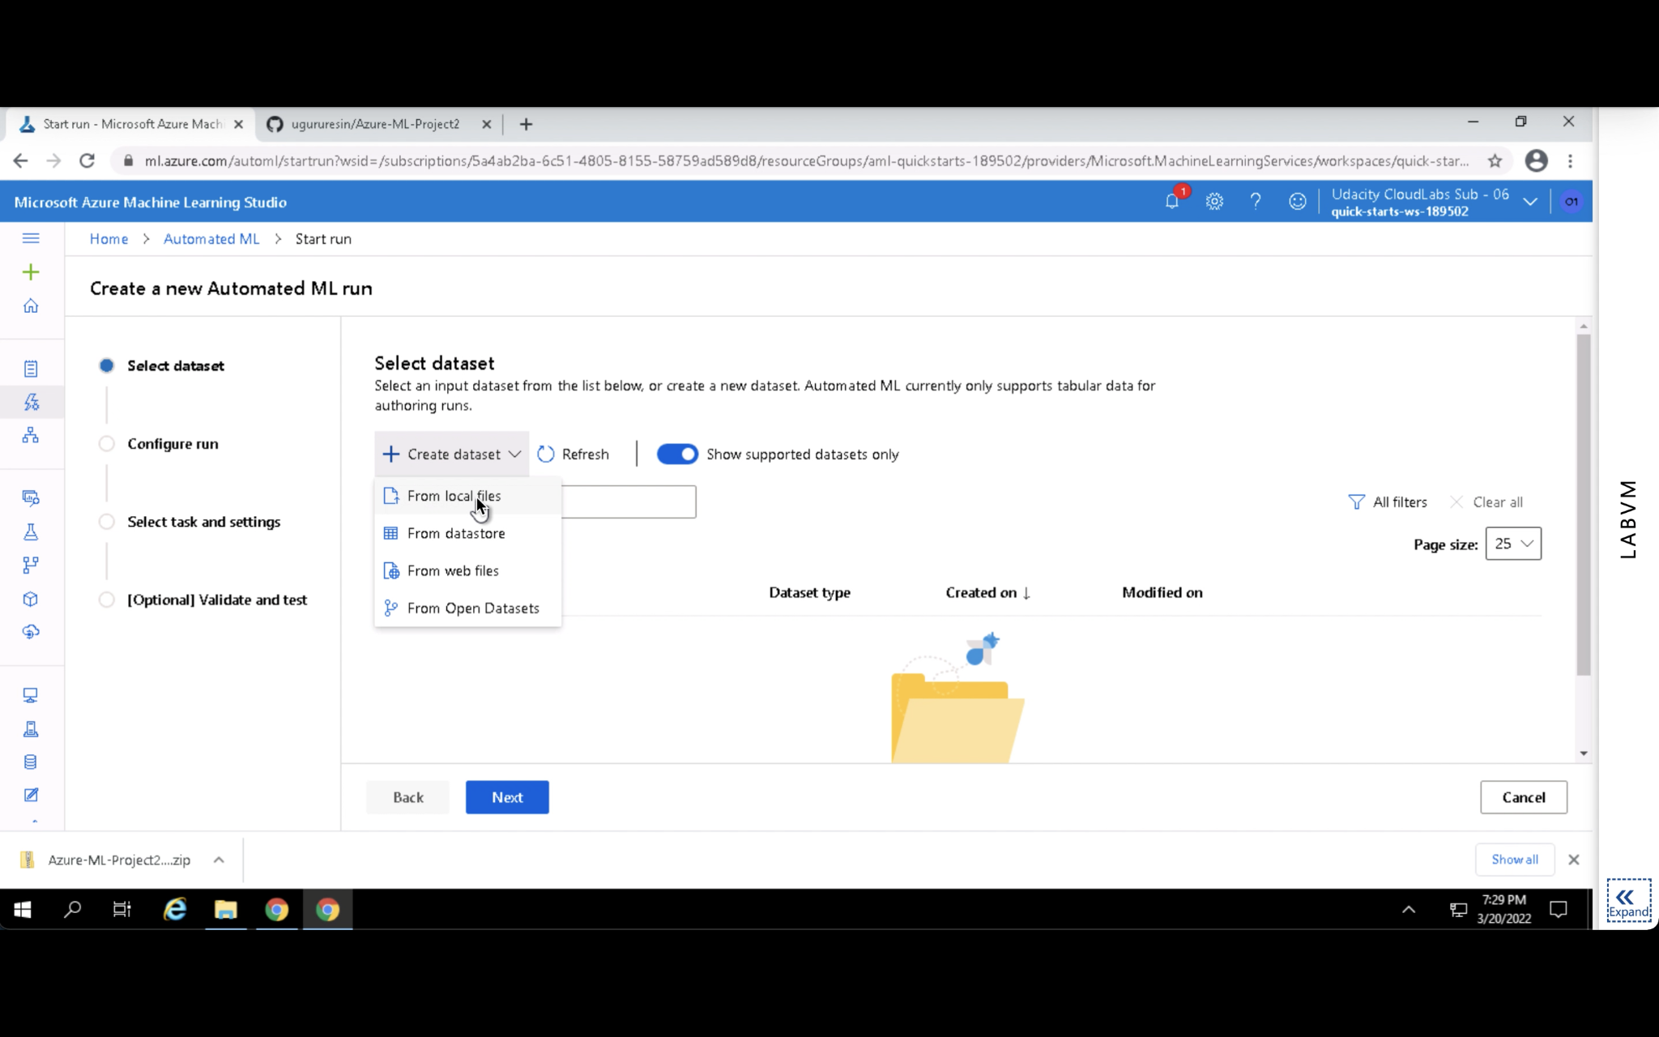

Slide 6
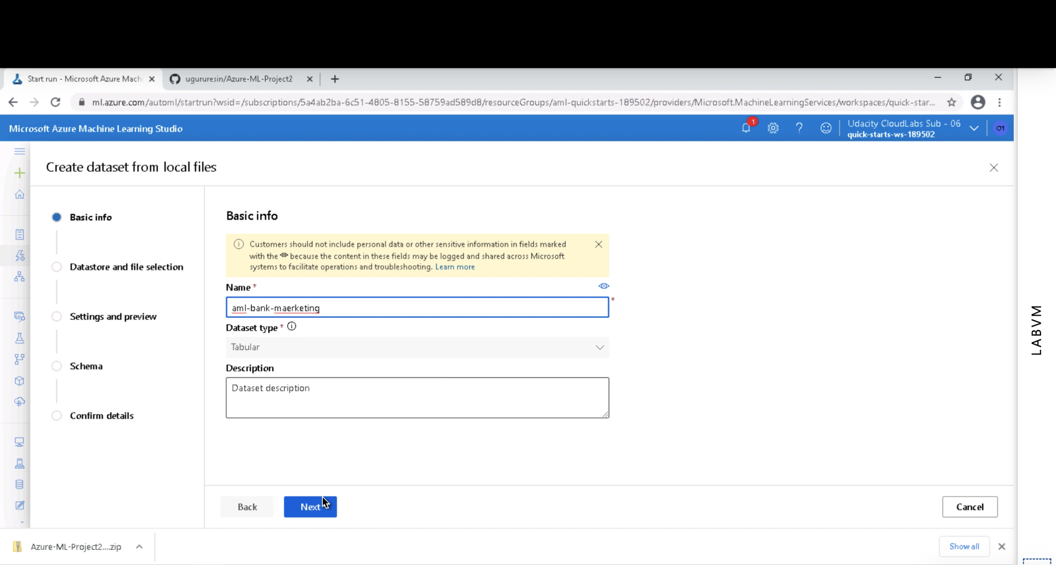

Slide 7
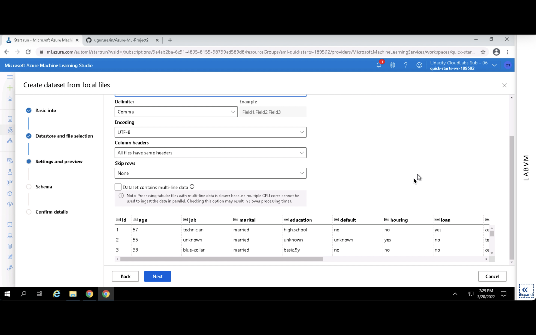

Slide 8
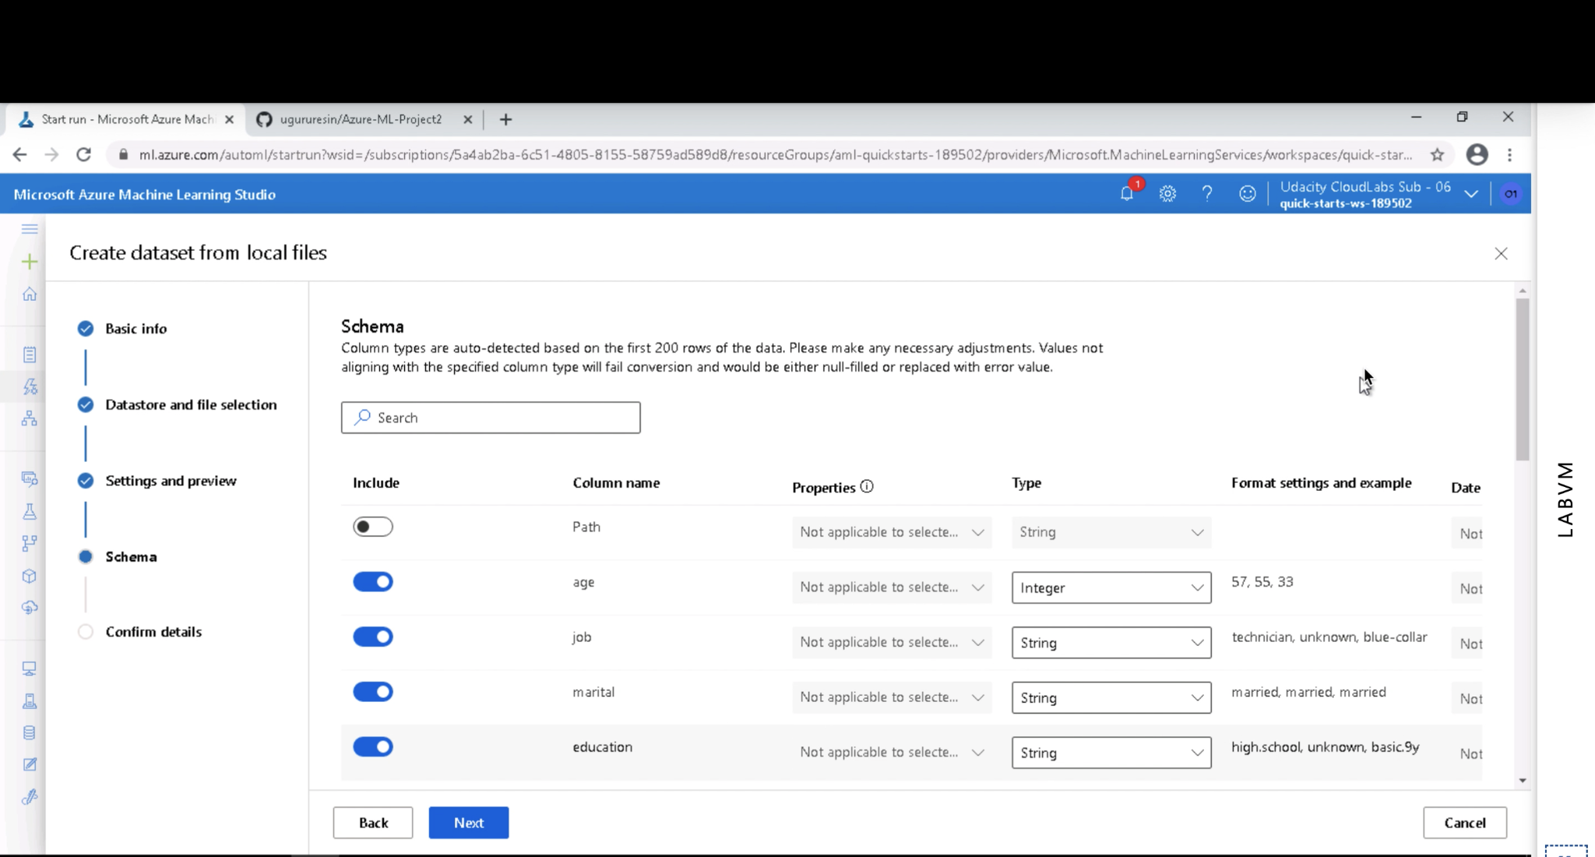

Slide 9
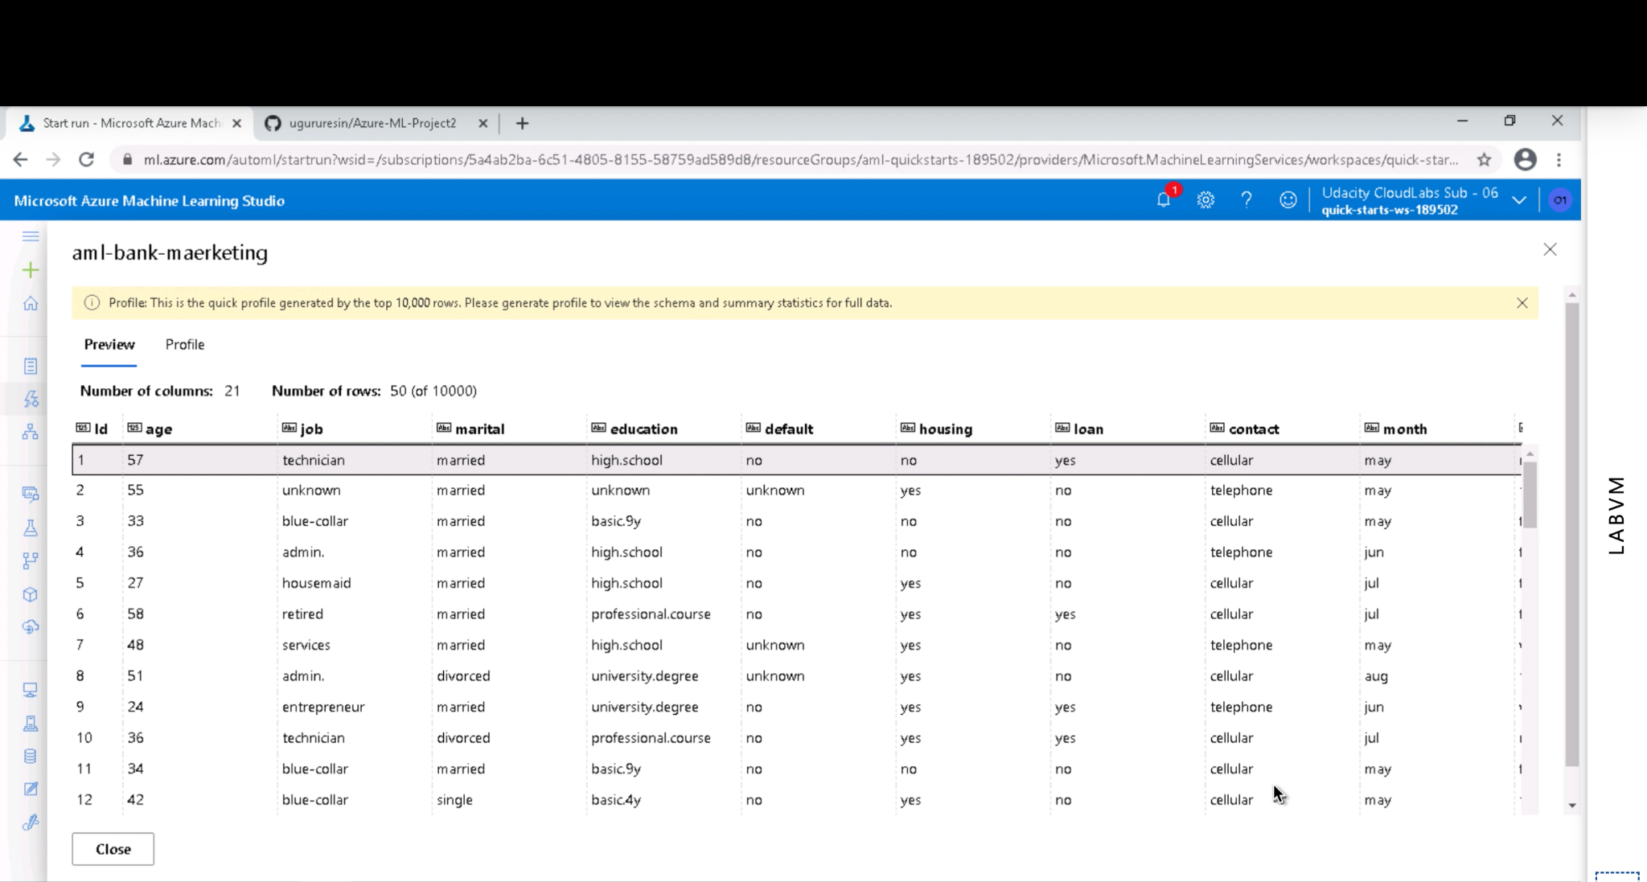

Slide 10
Task 4: Build the Predictive Pipeline
Built a prediction pipeline in Azure ML Designer with drag-and-drop components for a no-code, automated modeling process.
Included required pipeline steps: splitting data (70/30), training a model using AutoML classification, scoring a model, and evaluation.
Had utilized classification as the modeling task since the goal was to predict whether a customer has a term deposit subscription or not (yes/no).
AutoML learned a number of models (e.g., Logistic Regression, Random Forest, LightGBM) and selected the best one based on AUC.
The visual pipeline was saved, published, and deployed successfully to aid endpoint generation for real-time inference.

Slide 11
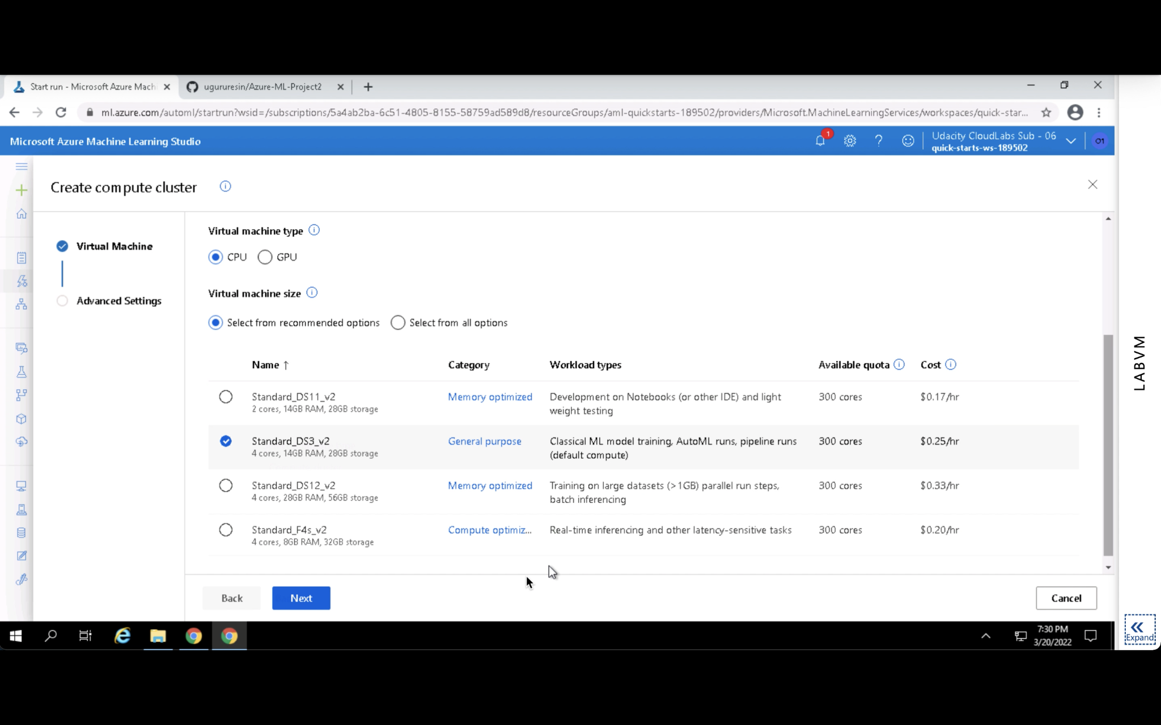

Slide 12
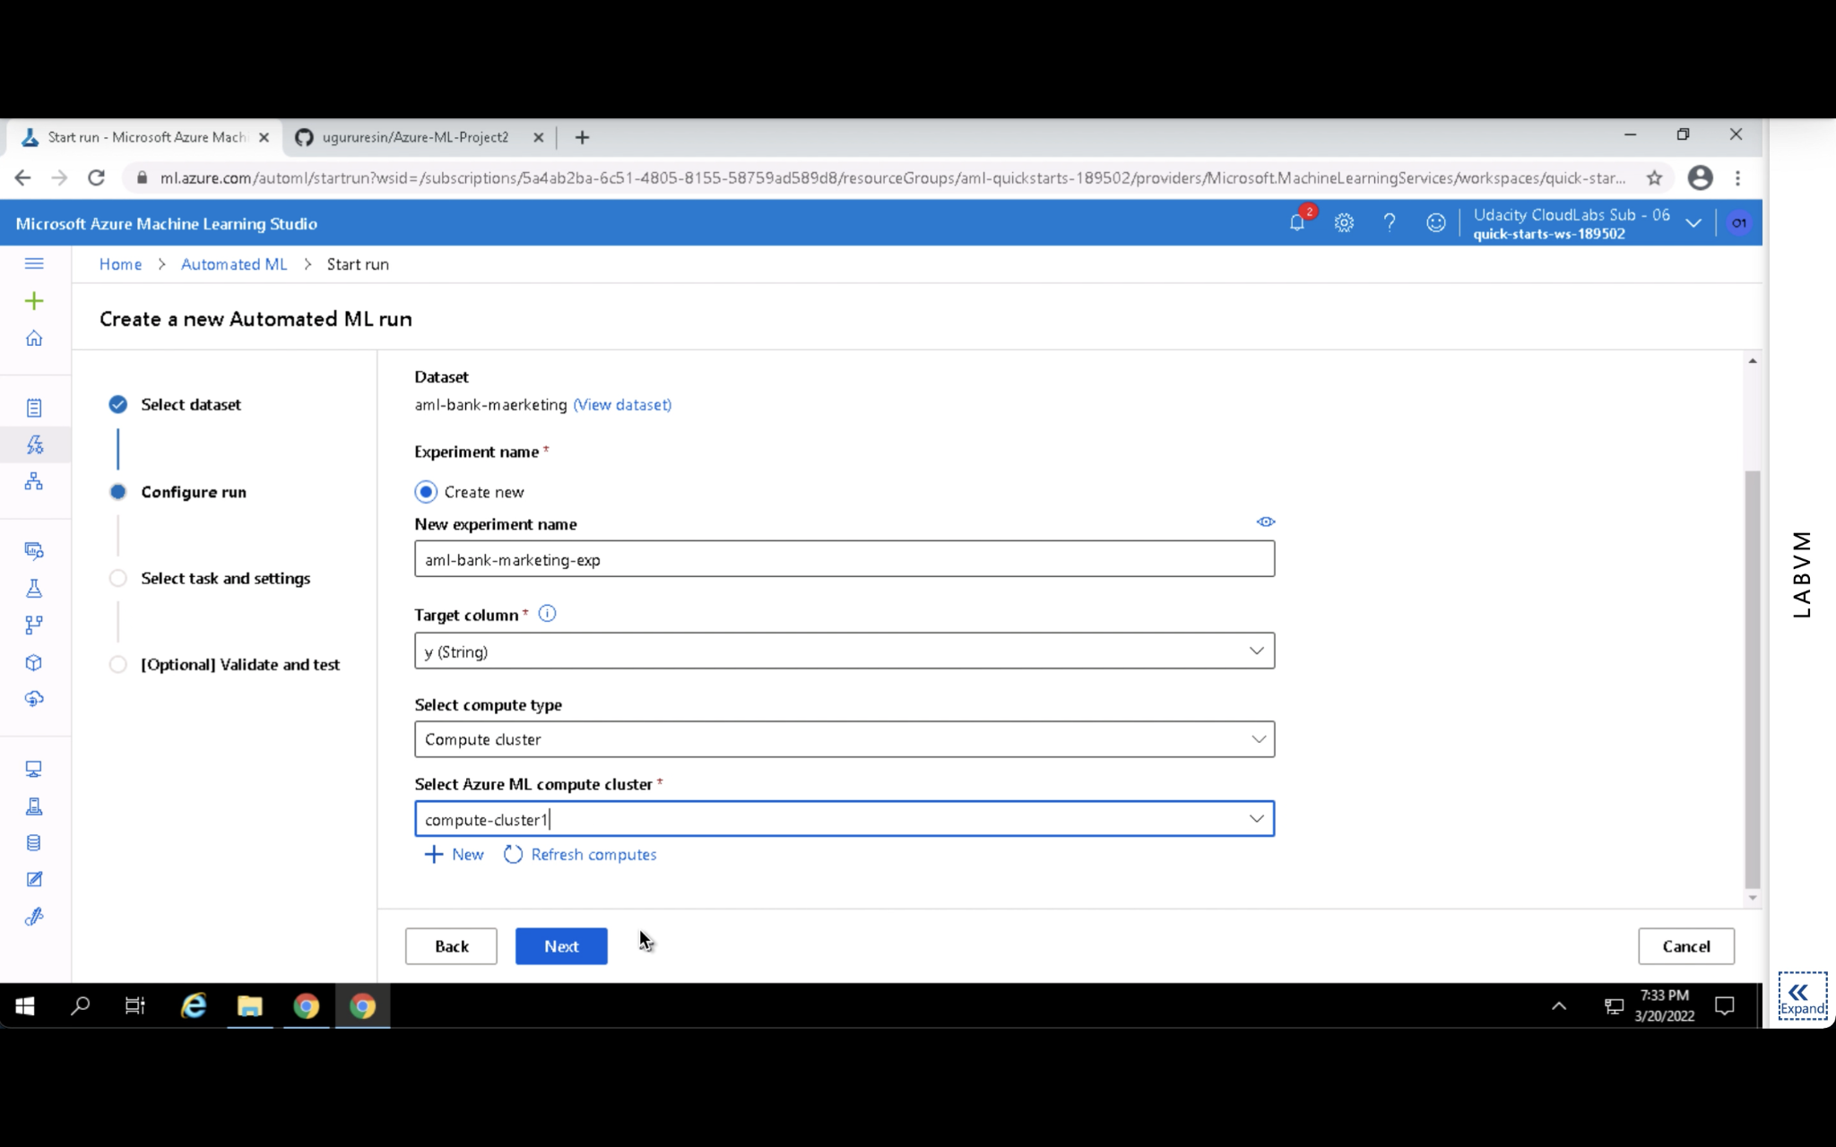

Slide 13
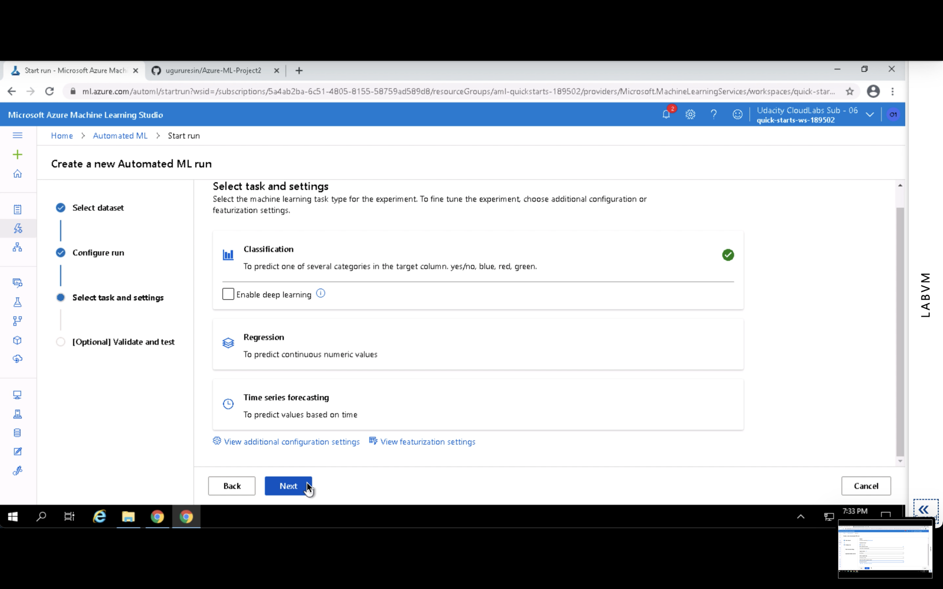

Slide 14
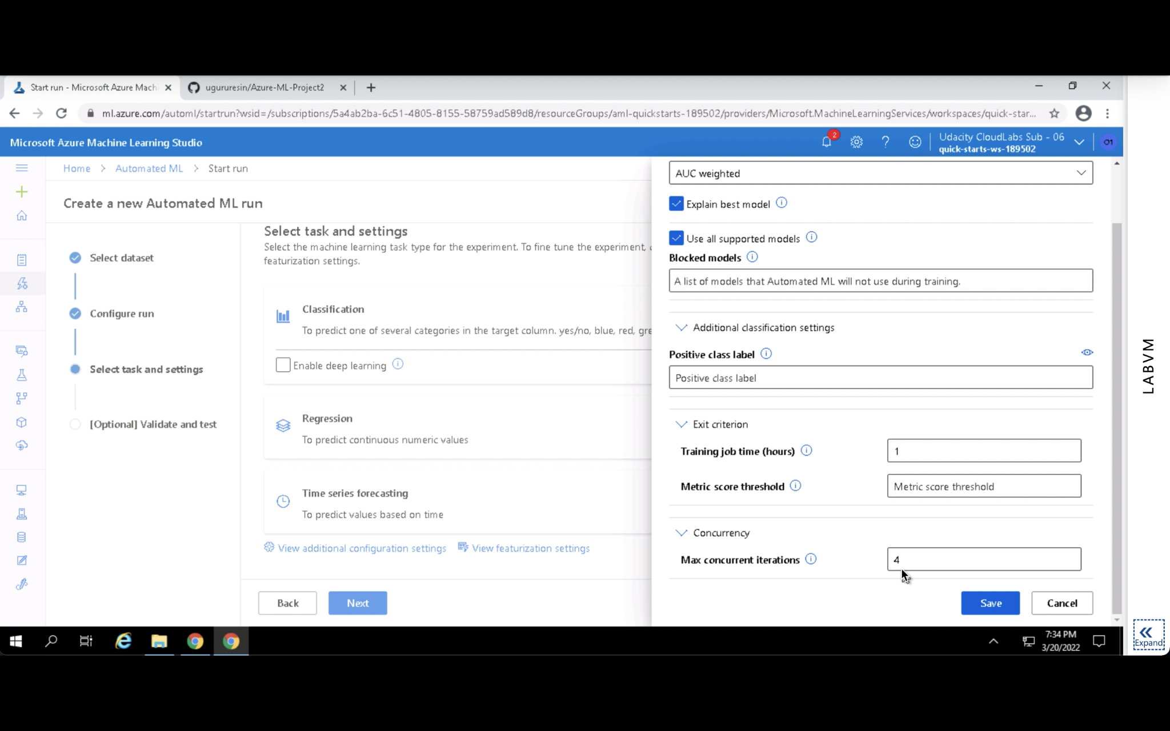

Slide 15
Task 5: Evaluate and Interpret Model Results
The pipeline was executed seamlessly, and the optimal model achieved 91.7% accuracy and AUC of 0.948, indicating superb classification performance.
Precision, recall, and ROC curves also ensured the strength of the model, especially for imbalanced class prediction (yes/no subscription).
The confusion matrix indicated negligible false positives and false negatives and accordingly implied good customer targeting for marketing campaigns.
For real-world usage, the model helps financial institutions determine potential customers that are highly likely to subscribe to term deposits in a very efficient manner.
The model meets the first prediction objective by accurately forecasting subscription probability and guiding actionable business decisions.

Slide 16
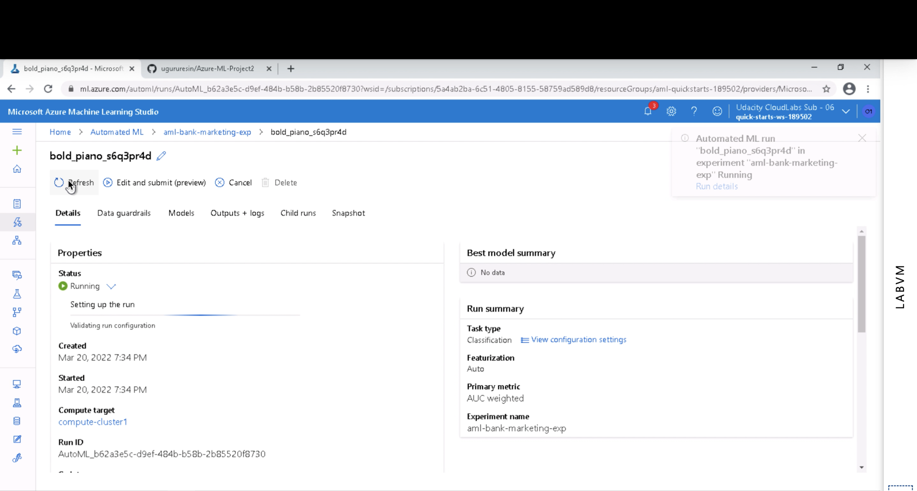

Slide 17
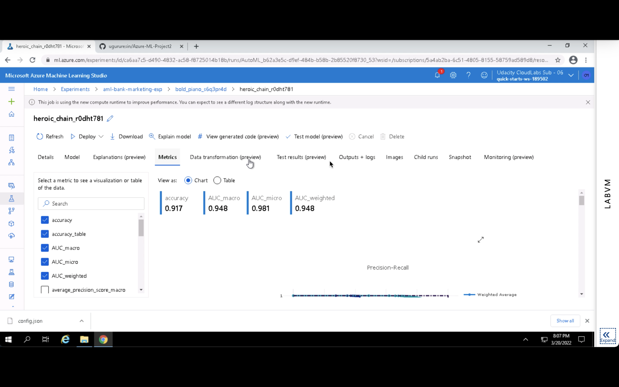

Slide 18
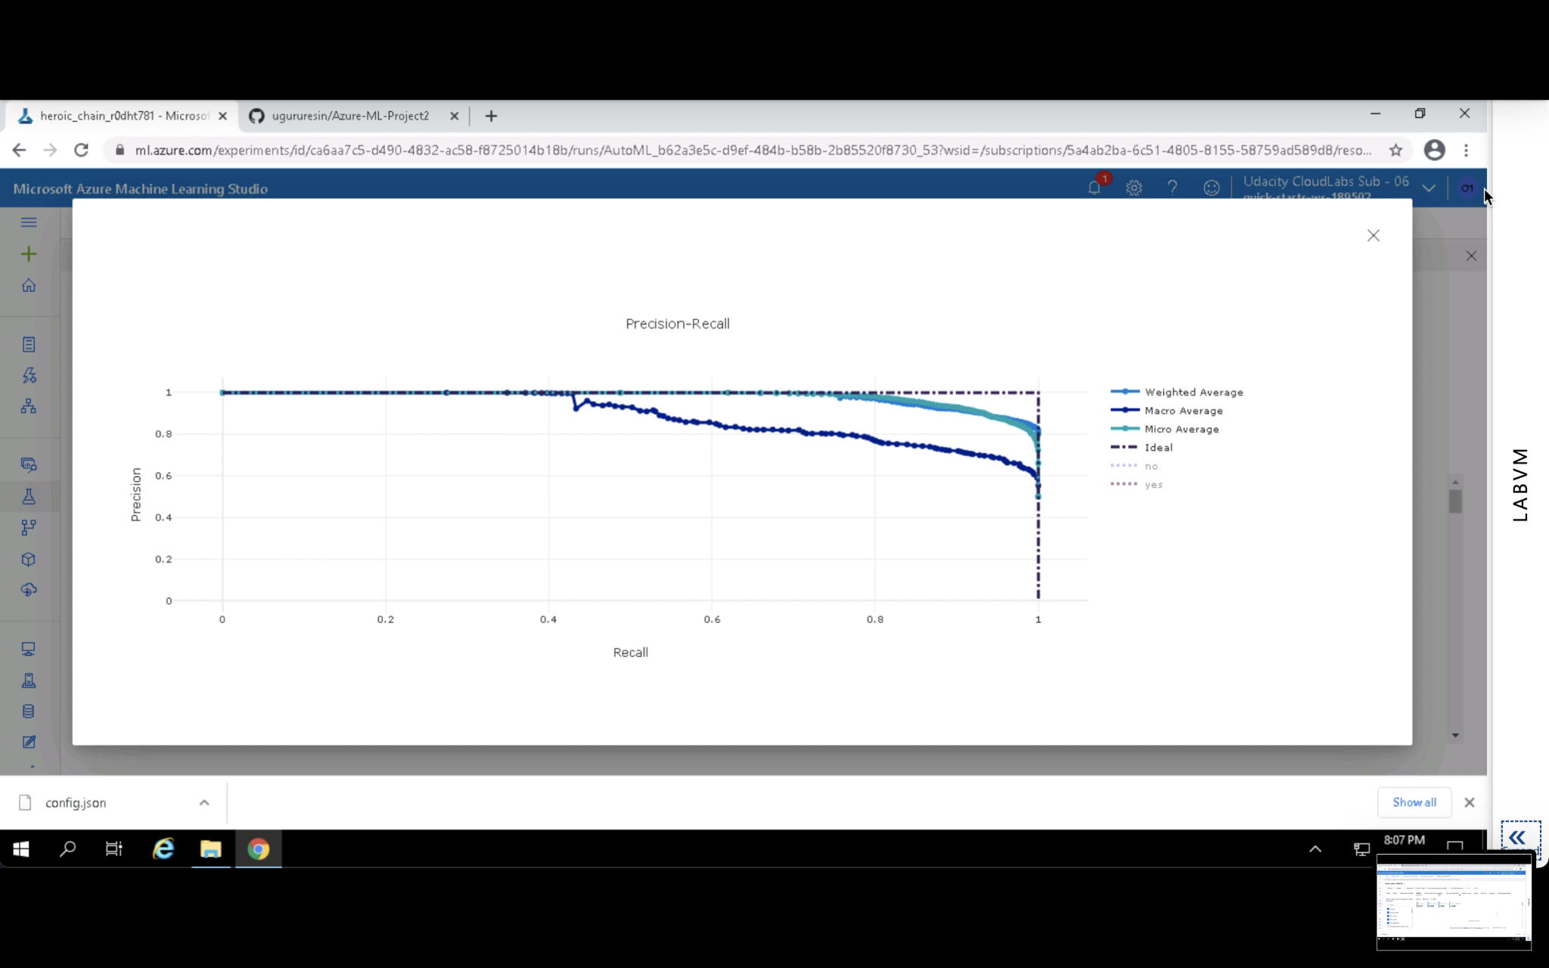

Slide 19
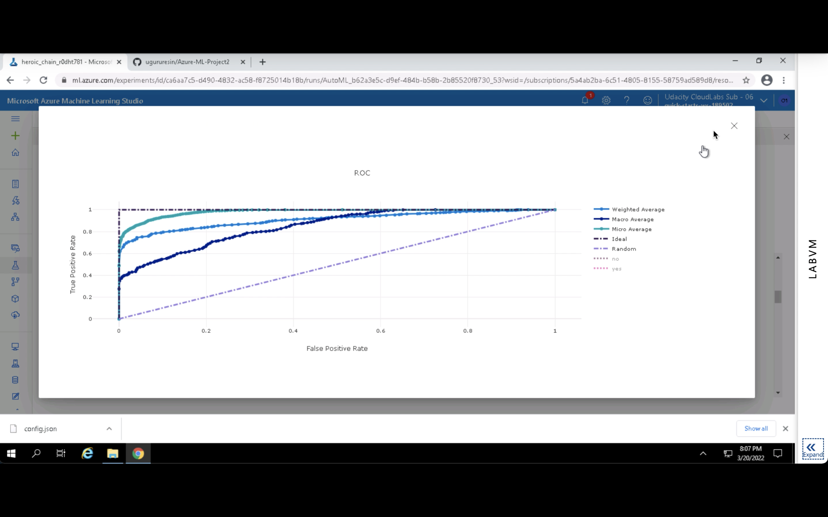

Slide 20
Task 6: Discuss Business Relevance
The model for prediction allows banking institutions to identify most likely customers to subscribe to a term deposit, creating more effective and targeted marketing campaigns.
Focusing efforts on high-probability leads, the bank can reduce campaign costs and increase return on investment (ROI).
The model allows for data-driven decision-making and away from blanket outreach to personalized marketing strategies.
Data from the model can also be used to refine customer segmentation, promoting long-term interaction and retention.
Ultimately, this forecasting solution enhances financial service providers' strategic planning and competitiveness in acquiring customers.

Slide 21
Task 7: Ethical and Social Considerations
The model will inadvertently benefit or harm specific demographic groups on the basis of biased historical data (e.g., age, nature of job).
Customer personal data must be securely processed to preserve privacy and comply with data protection regulations (e.g., GDPR).
AutoML must be audited so that model decisions are interpretable and intelligible to stakeholders.
Prediction-powered decision-making for marketing can benefit but can also drive vulnerable populations, proper ethical use must be addressed.
Regular checks, anonymization of data, bias detection tools, and fairness-aware training will reduce risks.

